Slide 1

Enjoy Bandung
Jonathan Christie
M20W7257

Slide 2

What & Who?
To Introduce
To Promote
To Encourage

Slide 3

Features
One Pager
Mobile Compatibility
User-Friendly

Slide 4
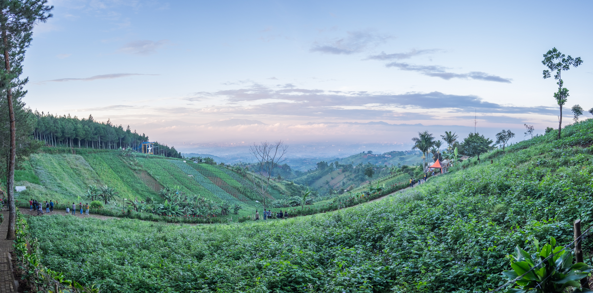
What to Improve

Slide 5
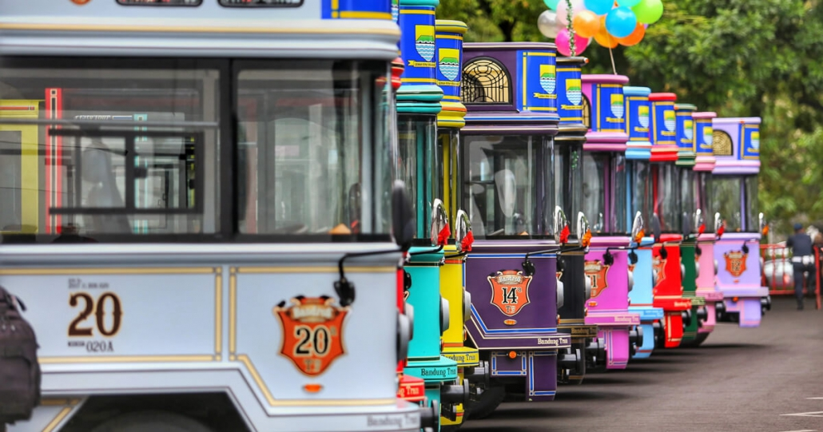
Demo

Slide 6

Question

Slide 7
THANK YOU!

